Slide 1
Lecture 3: KNOWLEDGE MANAGEMENT SYSTEMS LIFE CYCLE

Slide 2
CHALLENGES IN BUILDING KM SYSTEMS
Culture — getting people to share knowledge
Knowledge evaluation — assessing the worth of knowledge across the firm
Knowledge processing — documenting how decisions are reached
Knowledge implementation — organizing knowledge and integrating it with the processing strategy for final deployment

Slide 3
CONVENTIONAL VERSUS KM SYSTEM LIFE CYCLE
Key differences:
Systems analysts deal with information from the user; knowledge developers deal with knowledge for company specialists
Users know the problem but not the solution; company specialists know the problem and the solution
System development is primarily sequential; KMSLC is incremental and interactive

Slide 4
Conventional Versus KM System Life Cycle (cont.)
System testing normally at end of cycle; KM system testing evolves from beginning of the cycle
System development more extensive than for KMSLC
Conventional system life cycle is process-driven “specify then build”; KMSLC is result-oriented “start slow and grow”

Slide 5
Conventional Versus KM System Life Cycle (cont.)
Key similarities:
Both begin with a problem and end with a solution
Both begin with information gathering or capture
Testing is essentially the same to make sure the system is right and it is the right system
Both developers must choose the appropriate tool(s) for designing their respective systems

Slide 6
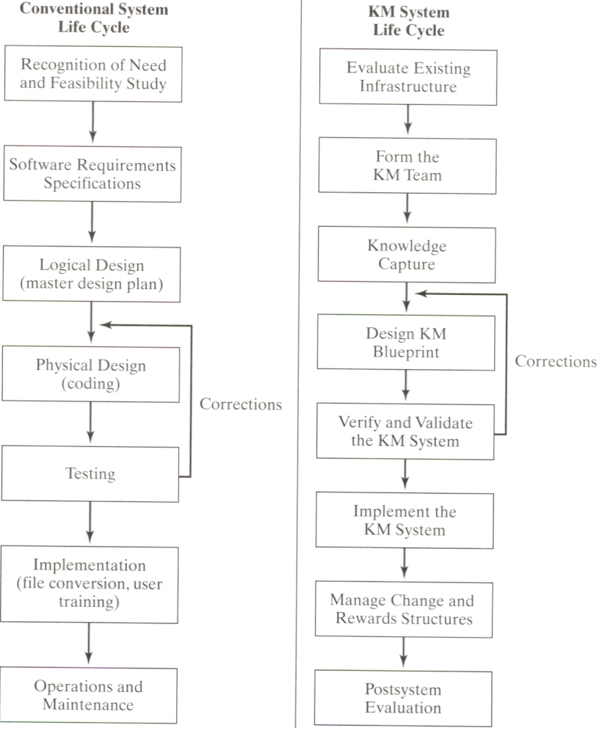
SDLC vs. KMSLC

Slide 7
Users Versus Knowledge Workers
Attribute User Expert
Dependence on system High Low to nil
Cooperation Usually cooperative Cooperation not required
Tolerance for ambiguity Low High
Contribution to system Information Knowledge/expertise
System user Yes No
Availability for system
builder Readily available Not readily available

Slide 8
KM System Development Life Cycle
Evaluate existing infrastructure
Form the KM team
Knowledge capture
Design KM blueprint (master plan)
Test the KM system
Implement the KM system
Manage change and reward structure
Post-system evaluation

Slide 9
Evaluate Existing Infrastructure
System justification:
Will current knowledge be lost through retirement, transfer, or departure to other firms?
Is the proposed KM system needed in several locations?
Are experts available and willing to help in building a KM system?
Does the problem in question require years of experience and cognitive reasoning to solve?

Slide 10
System Justification (cont.)
When undergoing knowledge capture, can the expert articulate how problem will be solved?
How critical is the knowledge to be captured?
Are the tasks non-algorithmic?
Is there a champion in the house?

Slide 11
The Scope Factor
Consider breadth and depth of the project within financial, human resource, and operational constraints
Project must be completed quickly enough for users to foresee its benefits
Check to see how current technology will match technical requirements of the proposed KM system

Slide 12
The Feasibility Question
A feasibility study addresses several questions:
Is the project doable?
Is it affordable?
Is it appropriate?
Is it practicable?

Slide 13
The Feasibility Question (cont.)
Areas of feasibility:
Economic feasibility determines to what extent a new system is cost-effective
Technical feasibility is determined by evaluating hardware and supportive software within company’s IT infrastructure
Behavioral feasibility includes training management and employees in the use of the KM system

Slide 14
The Feasibility Question (cont.)
Traditional approach to conducting a feasibility study:
Form a KM team
Prepare a master plan
Evaluate cost/performance of proposed KM
Quantify system criteria and costs
Gain user support throughout the process

Slide 15
Role of Strategic Planning
Risky to plunge with a new KM system without strategizing. Consider the following:
Vision — Foresee what the business is trying to achieve, how it will be done, and how the new system will achieve goals
Resources — Check on the affordability of the business to invest in a new KM system
Culture — Is the company’s political and social environment amenable to adopting a new KM system?

Slide 16
Matching Business Strategy With KM Strategy
Business
Environment
Strategic
Plan
Competitive threats; government regulations; customer threats
Regarding products or services, market, customers, suppliers, etc.
Impacts
Impacts
Impacts
Drives
KM
Strategy
KM
Technology
Enables
Quality and reliability of the infrastructure and IT staff and resources
Focus on competitive advantage, role of IT, and level of creativity and knowledge innovation
Enables

Slide 17
KM Team Formation
Identify the key stakeholders in the prospective KM system.
Team success depends on:
Caliber of team members
Team size
Complexity of the project
Leadership and team motivation
Promising more than can be realistically delivered

Slide 18
KNOWLEDGE CAPTURE
Explicit knowledge captured in repositories from various media
Tacit knowledge captured from company experts using various tools and methodologies
Knowledge developers capture knowledge from experts in order to build the knowledge base
Knowledge capture and transfer often carried out through teams, not just individuals

Slide 19
Knowledge Capture and Transfer Through Teams
Team performs
a specialized task
Outcome Achieved
Evaluate relationship between action and outcome
Knowledge stored in a form usable by others in the organization
Knowledge Developer
Feedback
Knowledge transfer method selected

Slide 20
Selecting an Expert
Knowledge base should represent expertise rather than the expert
Questions facing knowledge developer:
How does one know the expert is in fact an expert?
How would one know that the expert will stay with the project?
What backup should be available in case the project loses the expert?
How would the knowledge developer know what is and what is not within the expert’s area of expertise?

Slide 21
Role of the Knowledge Developer
The architect of the system
Job requires excellent communication skills, knowledge capture tools, conceptual thinking, and a personality that motivates people
Close contacts with the champion
Rapport with top management for ongoing support

Slide 22
Central Role of the Knowledge Developer
KNOWLEDGE WORKER
CHAMPION
Progress
Reports
Prototypes
Demos
Support
Feedback
Solutions
KNOWLEDGE DEVELOPER
Interactive
Interface
User
Acceptance
Rules
Knowledge
Testing
KNOWLEDGE BASE
KNOWER

Slide 23
Design of the KM Blueprint
The KM system design (blueprint) addresses several issues:
System interoperability and scalability with existing company IT infrastructure
Finalize scope of proposed KM system with realized net benefits
Decide on required system components
Develop the key layers of the KM architecture to meet company requirements. Key layers are:
User interface
Authentication/security layer
Collaborative agents and filtering
Application layer
Transport Internet layer
Physical layer

Slide 24
Testing the KM System
Verification procedure: ensures that the system is right
Validation procedure: ensures that the system is the right system
Validation of KM systems is not foolproof

Slide 25
Implementing the KM System
Converting a new KM system into actual operation
This phase includes conversion of data or files
This phase also includes user training
Quality assurance is paramount, which includes checking for:
Reasoning errors
Ambiguity
Incompleteness
False representation (false positive and false negative)

Slide 26
Resisters of Change
Experts
Regular employees (users)
Troublemakers
Narrow-minded superstars
Resistance via projection, avoidance, or aggression

Slide 27
Question for Discussion
The goal of this project is to develop a consumer-lending knowledge base to guide the junior bank officer through the decision of whether an auto loan should be approved. In the loan department, there are experienced senior loan officers who are willing to share their knowledge with others. You have been assigned the job of building a KM system for the bank. Explain in detail the life cycle of this project.

